Slide 1
Well-Architected Cost Optimization Assessment
Engagement kick-off
Presented by: xxx
Date: xxx

Slide 2
Conditions and terms of use
© Microsoft Corporation. All rights reserved.
You may use these training materials solely for your personal internal reference and non-commercial purposes. You may not distribute, transmit, resell or otherwise make these training materials available to any other person or party without express permission from Microsoft Corporation. URL's or other internet web site references in the training materials may change without notice. Unless otherwise noted, any companies, organization, domain names, email addresses, people, place and events depicted in the training materials are for illustration only and are fictitious. No real association is intended or inferred. THESE TRANING MATERIALS ARE PROVIDED "AS IS"; MICROSOFT MAKES NO WARRANTIES, EXPRESS OR IMPLIED IN THESE TRAINING MATERIALS. 1
1 For a more detailed description of confidentiality, see the slide at the end of the presentation.

Slide 3

Agenda
 | Introductions
 | Overview
 | Engagement Agenda
 | Audience and Prerequisites
 | Deployments

Slide 4

Introductions
Please introduce yourself and provide some background:
Your name
Your role
Current projects and/or activities you’ve been working on
Microsoft Confidential

Slide 5
Introduction
Well-Architected Cost Optimization Assessment Overview

Slide 6

Overview
Microsoft Azure Well-Architected Framework​
Architecture guidance and best practices, created for architects, developers and solution owners, to improve the quality of their workloads, based on 5 aligned and connected pillars​
Cost Optimization | Operational Excellence | Performance Efficiency | Reliability | Security
https://aka.ms/architecture/framework

Slide 7

Overview
What is a Well-Architected cost optimization assessment?
The Well-Architected Cost Optimization Assessment assesses an Azure workload against the cost optimization pillar of the Microsoft Azure Well-Architected Framework.
This 2-day engagement covers a range of technical topics from Compute, Data and Networking, but always through a focused cost optimization lens
As part of this delivery there will be an end-to-end review of an existing application or proposed design, to identify critical cost optimizations opportunities.
​
The deliverables include a final report with findings and suggestions.​

Slide 8
Engagement Agenda
Engagement Approach

Slide 9
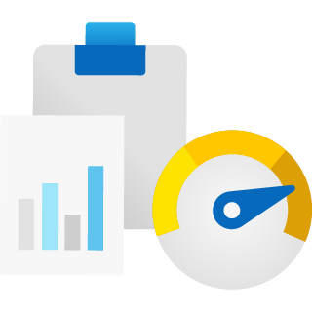
What will be Assessed?
Delivery Scope
One production state workload.
A customer workload is a collection of assets (infrastructure, applications, and data) that supports a common business goal or the execution of a common business process.
Delivery flow
Discovery from the workload in scope to identify potential optimizations based on Azure Advisor, and a questionnaire.
Out of Scope
Guarantee cost reduction or potential savings
Remediation during the assessment delivery
Customization of dashboards

Slide 10

Assessment Timeline
CE
WO
EXEC
SME
MS
Day 2
Day 1
TIME DISTRIBUTION | Morning
 | Afternoon
Kickoff
Azure Well-Architected Review
(Workbook, assessment survey & analysis)
Analysis & generate reports
Internal review
CE
WO
SME
EXEC
MS
WO
Workload Owner / Architect
Introduction of workload and workbook deployment
EXEC
Executive / Sponsor
SME
Tech SMEs
CE
Microsoft Customer Engineer
CE
WO
SME
CE
WO
SME
MS
Microsoft CSAM & CSA
Azure Well-Architected Review
(Workbook, assessment survey & Azure Advisor)
Present executive summary & assessment recommendations report
Closeout & Survey
CE
WO
SME
CE
WO
SME
EXEC
MS

Slide 11
Survey & Deployments

Slide 12

Deployments
Well-Architected Cost Optimization Workbook​

Slide 13
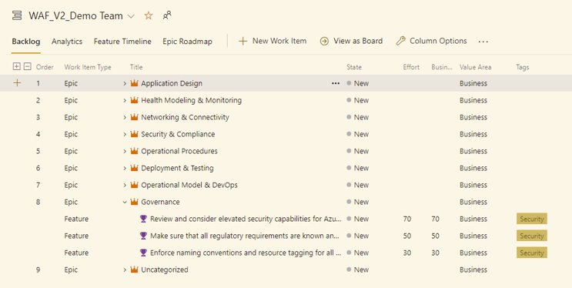
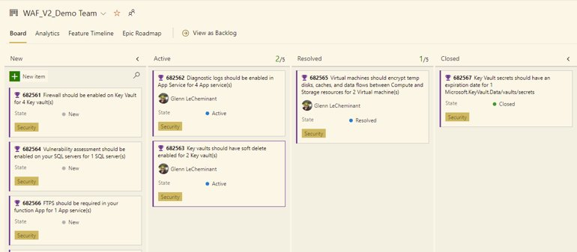
Azure DevOps Recommendations Import​

Slide 14
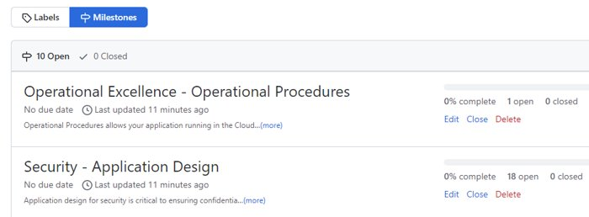
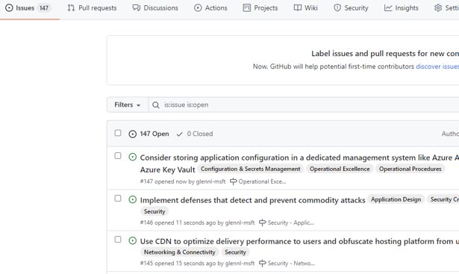
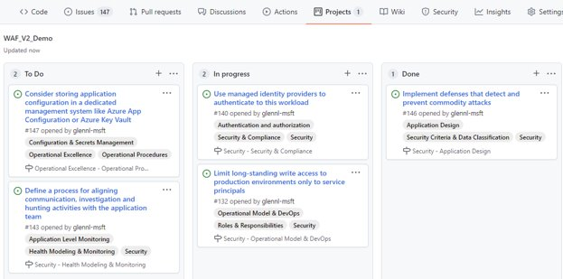
GitHub Recommendations Import

Slide 15
Deliverables
Azure Monitor Workbook | Final Report
WAF Cost Optimization Workbook ​ Resources per subscription​ Resource & Resource Group tagging ​ VM skus​ Networking​ Storage​ App Service Plans​ SQL Server / MI / DB AHUB​ Log Analytics Data Ingestion​ Orphaned resources​ Windows & SQL HUB​ Dv2 to Dv3 resize opportunity​ App Service state (Web & Functions), VM state (Stopped/Deallocated)​ Storage Accounts and Recovery Services Vaults Replication​ Storage Accounts not V2 type | Management-level closeout presentation of the findings and their impact to cost optimization.

Slide 16
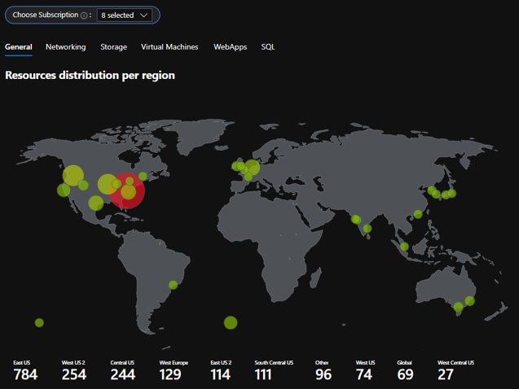
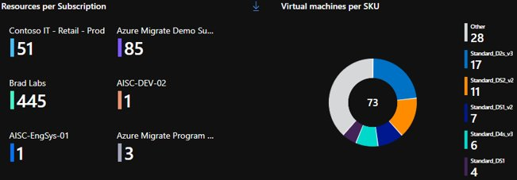
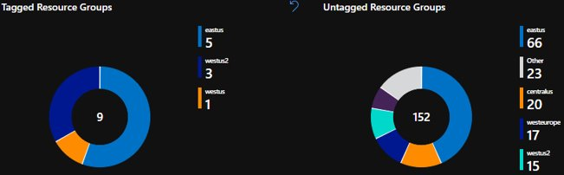
Well-Architected Cost Optimization Azure Monitor Workbook​
An Azure Monitor Workbook will be deployed. It helps identify waste and resources optimization opportunities that will enable you to maximize the efficiency of your cloud spend.​​

Slide 17
Cost optimization design principles
Choose the correct resources
Set up budgets and maintain cost constraints
Dynamically allocate and de-allocate resources
Optimize workloads, aim for scalable costs
Continuously monitor and optimize cost management
Notes:
A cost-effective workload is driven by business goals and the return on investment (ROI) while staying within a given budget. The principles of cost optimization are a series of important considerations that can help achieve both business objectives and cost justification.

Slide 18
Design for cost
Cost model
Capture clear requirements.
Estimate the initial cost.
Define policies for the cost constraints defined by the organization.
Identify shared assets.
Plan a governance strategy.
Architecture
Check the cost of resources in various Azure geographic regions
Choose a subscription that is appropriate for the workload.
Choose the right resources to handle the performance.
Compare consumption-based pricing with pre-provisioned cost.
Use proof-of-concept deployments
Choose managed services when possible.
Notes:
Cost modeling is an exercise where you create logical groups of cloud resources that are mapped to the organization's hierarchy and then estimate costs for those groups. The goal of cost modeling is to estimate the overall cost of the organization in the cloud.
Capture clear requirements.
Estimate the initial cost.
Define policies for the cost constraints defined by the organization.
Identify shared assets.
Plan a governance strategy.
At the end of this exercise, you should have identified the lower and upper limits on cost and set budgets for the workload.

Slide 19
Monitor cost
Monitor
Create spend reports
Use tags to build reports
Use Azure built-in roles for cost
Respond to alerts and have a response plan according to the constraints
Adopt both proactive and reactive approaches for cost reviews
Analyse the cost at all scopes by using Cost analysis
Detect anomalies
Use Visualization tools to analyze cost information.
Notes:
Continue to monitor the workload by using the right resources and sizes.
Keep informed about how your organization's costs evolve over time. Use the following techniques to properly understand and manage your spending.

Slide 20
Optimize cost
Optimize
Review the underutilized resources
Continuously take action on the cost reviews
Use discount prices
Azure Reservations
Savings plan for Compute
Azure Hybrid Benefit
Have a scale-in and scale-out policy
Revaluate design choices
Notes:
Continue to monitor the workload by using the right resources and sizes.
Review your resources and remove any that aren't being used.
Azure has many discounts that your organization should take advantage of to save money – Reservations, Savings plan for Compute, AHB (See slide 41)

Slide 21



Managing cloud spend across the organization is becoming increasingly difficult
IT executives
Finance teams
Business units
We need to better understand cloud spend across the company to ensure we are getting the most from our budget.
We need to improve forecast accuracy of cloud spend and drive more accountability from project owners.
We need to optimize the cloud usage and costs of our projects to show an even stronger ROI.
Notes:
We've learned from previous that managing cloud spend has become a major challenge for our customers today. In order for organizations to be successful in cloud financial management, we need to have IT, finance and business teams to be aligned altogether.
Cloud is more agile, quick and with scalability oftentimes there may be areas where IT teams and finance may not be aligned to their cloud budget. So it's critical that organizations have a strong governance structure and processes where IT teams can better understand cloud spend across the company to ensure they are deploying optimal resources.
For finance, it's important to be aligned with IT teams to discuss and improve forecast accuracy of cloud spend and accountability from project owners. For our business units, it's important to make sure that they're teaming up with IT and finance teams to optimize cloud usage, to increase the overall ROI of their cloud environment.

Slide 22
Current state of cloud financial management
Past
Current state
Challenges
Impact
Technology teams had to get approvals from Finance on what they will be spending, what the costs will be, and its outlook
Success in quicker cloud service deployment
Costs as after thought
Unexpected spikes in costs
Degrading profitability
Determination to meet company goals and get services up and running
Inadequate communication
Cross-organizational conflicts
Delay in critical projects
Faster and better product releases at lower costs
Lack of technical skillset
Run into scaling issues
Slows or halts cloud adoption
Faster migration to due to pandemic
Misalignment on cloud governance
Lack of team’s collaboration to set a robust organizational-wide governance strategy
Notes:
And then now going into the current state of the cloud financial management.
With on premise environments in the past, the process for technology teams would be that they would request a certain amount of capital to purchase IT assets and then finance the business teams would approve the budget to determine what you'll be spending and that was all done up front. Now with the cloud, it creates agility for a quicker go to market strategy and to deploy services much quicker. However, this also creates several challenges for our customers as the IT teams are thinking about cost of deploying those services as an afterthought.
Also, organizations have to realize and align with different teams to make sure that everyone understands and communicates efficiently on the cost of project, the costs per month and also understanding if they're using the optimal infrastructure for their environment. In addition, the concept of cloud governance will need to be in place to make sure that organizations are successful across their cloud cost, budget and that they're maximizing their cloud usage in their environment.

Slide 23

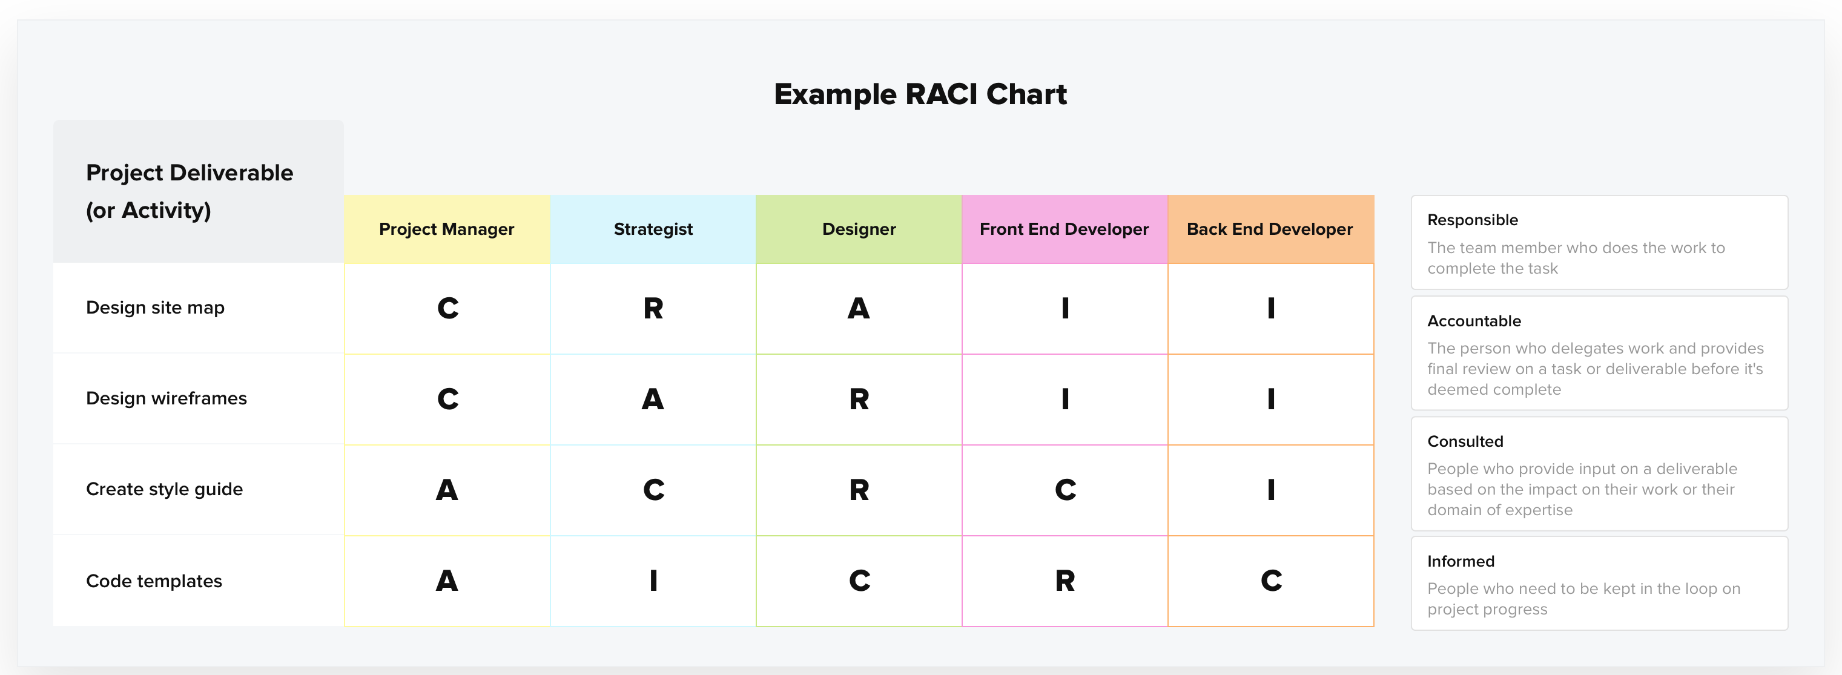
Top Cost Optimization Challenges: Collaboration is a challenge as organizations transition to “shared responsibility” cloud management models
Forecasting,
shared costs
Before workload implementation it's very difficult to get good cost estimates, because most cloud vendors only show list price. Even when an actual price is given (such as during service creation), the prices often scale significantly based on load (which is unknown).
– IT LEAD
Reducing waste or unused resources
Reducing waste is difficult, because often projects are marked as complete and handed off to the operations team, but there is not always a clear task to review usage after a period of time to make sure it still makes sense. – IT LEAD
Lack of Accountability
Teams are not taking cost optimization into consideration. If performance needs are not being met, teams are able to identify that and will resize resources appropriately… they are not checking to see if the same performance can be met using a smaller resource size. Teams are also not implementing other controls to optimize spend such as lifecycle policies, log retention policies, etc. – FINANCE
Aligning Finance to IT teams
The biggest challenge that I face is determining whether the proposed architecture / resources are appropriately sized. Teams will generally guess on resource sizing without doing more due diligence and research. This is hard for me to confirm because it requires application specific knowledge. – FINANCE
Implications: As cloud cost optimization becomes more collaborative, organizations would benefit from guidance on roles and responsibilities (e.g. RACI matrix).
Notes:
Let’s talk about some pain points that potentially should be targeted to bring value to training. The overarching theme across all the pain points is collaboration, where there’s a number of challenges that pop up. Because of this transition to a shared responsibility model—more specifically, forecasting shared costs, reducing waste or unused resources, lack of accountability, aligning finance to IT teams.
With new shared responsibility models, there’s exists a gap in identification of roles. A RACI card (roles and responsibilities) could provide some needed guidance on roles and responsibilities, and help users find the appropriate learning path.

Slide 24

FinOps is a framework that accelerates business value
Operating models for Technical and Financial leadership: Share the same language and processes to monitor cloud spend and maximize the value of cloud adoption
FinOps Operating model
Tracking and allocating costs
Optimizing capacity usage
Inform
Optimize
Operate
FinOps
Transparency in creating shared accountability by showing teams what they are spending and why
Identify and measure efficiencies within optimization, accelerating the value of services consumed
Definition of the processes that enable the technical, financial and business unit goals
Optimizing billing model usage
Reference: What is Finops by Finops Foundation (www.finops.org )
Notes:
What really is FinOps?
So FinOps is an operating tool and a model that brings the technology and finance leadership team to share the same language and processes to manage the cloud spend, maintain velocity and to maximize the value of their cloud infrastructure. So here you can see the three pillars of the Finn OPS operating model.
So first, “Inform” this is to create as much transparency and visibility to the overall cloud costs allocation and creating a shared accountability by showing teams what they're spending and why.
“Operate” is to really refine and share IT finance and business leadership goals to focus and scale operational efforts for continuous improvements in the cloud environment with increased collaborations amongst the teams.
And then… “Optimize” is to empower teams to make right optimization actions based on their organization goals, which we'll discuss, furthermore, regarding the tools around optimization.
So to summarize, FinOps is not just about saving money, it's much more than that, by incorporating FinOps practice to your organization, your cloud spend can drive more revenue, enable quicker go to market strategy, help you maximize ROI, and most importantly to help you achieve your business outcomes.

Slide 25
FinOps Stakeholders
Notes:
So we've talked about cloud economics at an all-up? level. We've discussed what are some of the benefits the cloud can provide.
We've discussed some of the challenges that organizations can face in actually driving value and how FinOps as a process and a set of resources can help you drive a more optimized environment that has both processes and controls in place to really allow you to manage. Now let's click a step deeper and look at some of Microsoft specific tools are that can help you both develop a FinOps practice as well as optimize your spending on an ongoing basis.

Slide 26

FinOps Team Structure
A Cloud Center of Excellence(CCoE)
FinOps Stakeholders
A Cloud Center of Excellence (CCoE) will span both technical & financial teams with the intent to:
Developers, Ops and Infrastructure
(Cloud Architect | Enterprise Admin)
Infrastructure Changes
Business Unit Owner
FinOps
Team
Manage the cloud strategy
Executive Sponsorship
Manage Governance
Finance Owner
Cost and Pricing Optimization
Share best practices
Reference: What is Finops/FinOps Team Structure by Finops Foundation (www.finops.org)
Notes:
So we talked about FinOps. We talked about the process, some of the tools and how FinOps and DevOps relate to each other but one of the really critical components of you know, developing a FinOps practice is actually enabling a team structure around it. We've included some notes here from the FinOps Foundation that really highlights how you might structure and think about their relationship and people involved in your FinOps practice. What is the working group that makes up a FinOps team and it may be, people from various disciplines coming together in order to create a cloud center of excellence or a cloud competency center to help develop a cloud strategy to manage the government and best practices and then to share those best practices, not just within that small working group, but within the rest of the organization to allow for both tracking, transparency and knowledge sharing across your organization as opposed to sitting dedicated within silos.

Slide 27

FinOps Central Team
 | usiness Teams: Budget Resource Control Lead Cultural Shift Measuring Cloud Business Value Define and manage KPIs
 | ngineering Teams: Cloud Cost Optimization Enable tracking and visibility of resource utilization Identify usage and spend anomalies Cloud governance and management
 | inance Teams: Cloud Cost Reporting Contractual model optimization Negotiate pricing and commitment Forecasting and predict spend
B
Engineering
Teams
Business
Teams
E
FinOps Central
Teams
F
Finance
Teams
Notes:
Engineering
Architects, Software engineers, data engineers, Sys Admins, Infra, DevOps, Platform
Finance
Financial Analyst, CFOs, Procurement managers, Technology procurement manager
Business
VP/Head of Infra, CTO, CIO, Head of CCOE

Slide 28
FinOps Stakeholder Responsibility
Goal: Make cloud data visible, transparent, and actionable to entire organization to drive financial accountability and accelerate cloud business value realization
FinOps Teams | Responsibility | Actions
Engineering | Map and track cloud spend Identify units to be tracked Define a management & governance Set tagging strategy & compliance Lead FinOps Initiative | Lead charge of FinOps Initiative Drive accountability for cloud spend Identify FinOps team stakeholders Analyze and track usage across environment and subscriptions
Finance | Define budgets and forecast Trending & variance analysis Direct Chargebacks Reservation and Commitment usage monitoring and alerting in place | Analyze details on where cloud spend is deriving from and supply any financial outcomes that can be attributed to those cloud solutions
Business | Set KPIs and budgets throughout organization Create benchmark scorecards Build a FinOps team Aligning organization on FinOps Shift in Culture of Financial Accountability | Gather team of Business leaders to better understand of how they use cloud solutions to drive business value Business ownership will also help you communicate any new requirements downstream.

Slide 29
FinOps | Inform
Build cost transparency and clarity through the Inform phase by identifying organizational units and mapping them to cloud resources for further analysis
Goal: Make cloud data visible, transparent, and actionable to entire organization
FinOps Teams | Responsibility | Actions
IT | Map and track cloud spend Identify units to be tracked Define a management & governance Set tagging strategy & compliance Lead FinOps Initiative | Lead charge of FinOps Initiative Drive accountability for cloud spend Identify FinOps team stakeholders Analyze and track usage across environment and subscriptions
Finance | Define budgets and forecast Trending & variance analysis Direct Chargebacks Reservation and Commitment usage monitoring and alerting in place | Analyze details on where cloud spend is deriving from and supply any financial outcomes that can be attributed to those cloud solutions
Business | Set KPIs and budgets throughout organization Create benchmark scorecards Build a FinOps team Aligning organization on FinOps Shift in Culture of Financial Accountability | Gather team of Business leaders to better understand of how they use cloud solutions to drive business value Business ownership will also help you communicate any new requirements downstream.

Slide 30
FinOps | Optimize
Implement some high-value/low-effort optimizations in the Optimize phase to build experience and engagement for future, more involved activities
Goal: Provide actionable recommendations to realize savings opportunities and increase efficiency in their cloud environment
FinOps Teams | Responsibility | Actions
IT | Overall spend optimization process Determine product efficiency (ex. refactor, re-size, re-architect) Leverage Billing constructs (Spot, Reserved Instances) | Rightsizing instances Deletion of unused resources Create Stop/Start of resources Commitment management Continous rightsizing Supplier price management
Finance | Create priorties for areas to target in optimization Analyze spending trends and variations Start to manage and track budgeting Determine accurate cloud spend forecast models | Partner with IT team to analyze and track billing data to determine cloud spend and forecasting Export cost reports for invoicing Manage usage and cost of cloud subscription Customer service charges such as chargeback to departments
Business | Monitor the effectiveness of optimization Tracking FinOps KPIs Driving accountability amongst the Team | Continue to build cultural shift and drive accountability to be efficient and effective in your cloud environment
Dashboards & Reporting
Direct Chargeback
Anomaly Alerts
Budgets & Forecasting
Fully loaded cost
Real-time decision making
Performance benchmarked
Compliant Accounting

Slide 31
FinOps | Operate
Enabling cross-units to create effective cloud spend management and governance policies
Goal: Continous improvement of the overall FinOps process to define, automate, and drive empowerment to achieve high cloud ROI
FinOps Teams | Responsibility | Actions
IT | Define governance and controls Define responsibilities and processes Continously improve and automate Continously educate your team on why FinOps is important Create enterprise-wide cloud business case | Gather teams to set expectations moving forward and recommend trainings on both technical topics and internal processes
Finance | Execute real time decision real-time cloud spend data to stakeholders Centralize rate optimization ownership Develop business cases for cloud-based workloads | FinOps actions are recorded, prioritized, and delivered against organization’s KPIs
Business | Empower teams to take action that leads to quantifyable results for the business Ensure organizational enablement Align strategic plans to business Incentivize teams to motivating to take further actions around optimization Measure business value achieved | Ongoing strategic reviews with stakeholders on optimization opportunities are planned and executed
Dashboards & Reporting
Direct Chargeback
Anomaly Alerts
Budgets & Forecasting
Fully loaded cost
Real-time decision making
Performance benchmarked
Compliant Accounting

Slide 32
How can Microsoft help you develop your FinOps practice?
Notes:
So we've talked about cloud economics at an all-up? level. We've discussed what are some of the benefits the cloud can provide.
We've discussed some of the challenges that organizations can face in actually driving value and how FinOps as a process and a set of resources can help you drive a more optimized environment that has both processes and controls in place to really allow you to manage. Now let's click a step deeper and look at some of Microsoft specific tools are that can help you both develop a FinOps practice as well as optimize your spending on an ongoing basis.

Slide 33





Azure FinOps
Vision
To empower your organization to understand their current Azure spend. We will help you establish your financial management practices and be your financial partners as you shift to a new cloud environment. This will help you address identified opportunities to maximize business value from IT investments
Key Objectives
Tracking and allocating costs
Optimizing capacity usage
Create a centralized FinOps Team
Develop clear understanding of Azure costs
Performance track & benchmark
FinOps
Optimizing billing model usage
Enable real-time decision making
Optimize your Azure usage
Goals
Business Outcomes
Drive cloud cost efficiencies
Improve operational processes
Increase visibility for your Azure spend
Empower CFO to evaluate Azure spend effectiveness
Act as liaison between your organization technical and financial teams
Provide industry expertise with tools and products
Improve your organization’s cloud satisfaction
Remove blockers to help drive success in Azure
Increase optimization to better manage services
Advise on FinOps Framework and capabilities
Optimize operations
Increase cross-collaboration amongst Finance and IT to share common goal
Increase agility and speed to market
Help your bridge Finance and IT teams to share same language and processes on Azure Cost Management
Notes:
What really is FinOps?
So FinOps is an operating tool and a model that brings the technology and finance leadership team to share the same language and processes to manage the cloud spend, maintain velocity and to maximize the value of their cloud infrastructure. So here you can see the three pillars of the Finn OPS operating model.
So first, “Inform” this is to create as much transparency and visibility to the overall cloud costs allocation and creating a shared accountability by showing teams what they're spending and why.
“Operate” is to really refine and share IT finance and business leadership goals to focus and scale operational efforts for continuous improvements in the cloud environment with increased collaborations amongst the teams.
And then… “Optimize” is to empower teams to make right optimization actions based on their organization goals, which we'll discuss, furthermore, regarding the tools around optimization.
So to summarize, FinOps is not just about saving money, it's much more than that, by incorporating FinOps practice to your organization, your cloud spend can drive more revenue, enable quicker go to market strategy, help you maximize ROI, and most importantly to help you achieve your business outcomes.

Slide 34









Azure FinOps
Establishes best practices on cloud financial governance
Identifies optimization opportunities and automate tasks
Drives accountability for cloud spend
Simplifies cloud cost management
Enables policy and data-driven decision making for cost take out
Forward thinking Application innovation
MSFT support and partnership throughout engagement
Customer Logo
Provides cost visbility for cloud control

Slide 35
Microsoft FinOps Framework
Inform
Optimize
Operate
FinOps Cultural Transformation
Financial Outcomes
Cloud Business Value
Azure Costs
Strategy
Optimize
Remove
Right-size
Reservation
Cost Optimization
Metrics and Reporting
Performance and Efficiency
Monitoring
Real-time Cost data
Visibility
FinOps Central Team
Skills readiness plan
FinOps adoption plan
Budget Planning & Forecasting
Accountability
Control and governance
Best practice
Shared Responsibility
Azure Native tools
Financial Governance
Data analytics
Improve and automate
Value realization
Educate
Continous Integration
Notes:
As we think about clicking into some of the principles, we'll start with a deeper dive into the cloud adoption framework and the cloud adoption framework is really across 3 core pillars. Business, platform, as well as workload from the business side, there are 2 components. It's really around defining a strategy and then planning on that execution. When we think about platform, it's about enabling readiness for your organization. Setting a blueprint and then development of governance principles that can help you achieve cloud success. From a governance perspective this is where some of the critical FinOps practices need to be incorporated and weaved in.
How do we establish a governance model that enables finance to talk to IT, IT to talk to finance and for clear transparency around what governance attributes need to be in place.
From a workload perspective, there is adopting the right. ----STOP PAUSE ------
----START-----
From a workload perspective we have to think about how you're going to architect your workloads in a way that is both operationally satisfactory where it'll achieve your technical goals, it'll achieve your reliability goals, you'll migrate effectively, and you'll migrate to secure and compliant environments.
But you also want to think about how do you layer on cost optimization in this approach? How do you ensure that you are taking advantage of amoptimized environment, not just a technologically sound environment? You want to layer both of those together to ensure you're achieving success.

Slide 36
FinOps Management Process
Governance and operations
FinOps strategic management process
Enable and automate
Every major enterprise its own set of policies, procedures, and processes for scaled IT operations. A mutually beneficial strategic cloud partnership depends on developing new governance structures and collaboratively adapting operational practices for the public cloud.
Strategic
Operational
Tactical
IT and Finance Strategy
IT Operating Model
Responsibilities and processes
Cloud Native Tools and Connectors
Cloud Governance
Security
Governance and Control
Tagging Taxonomy
Cost Optimization
Cost Optimization
Monitoring
Infused Intelligence
Value Realization
Metrics and Reporting
Improve and automate
Azure FinOps
Reference: www.finops.org
Notes:
I'm going to hand it over to Kevin to walk through a little bit of the FinOps management process and how we think about the end to end management of a FinOps process.
As we develop best practices for FinOps within your current cloud environment, it's extremely critical and important to make sure that every organization has a strong management and governance practices in place to scale IT operations and maximize the value of your cloud environment
At Microsoft we like to approach it in three key areas: strategic, operational and tactical.
Strategic in a way where it aligns the organization strategy around governance and management processes and combining the IT and finance teams as well as the overall business units to maximize the cloud infrastructure and to make sure that we have a cloud governance management process in place.
When you look at operational, there are responsibilities and processes and other operational areas to make sure that we are aligning all the business units together.
Lastly, after the governance and operations procedure, policies, and processes are in placed. Organizations have to communicate and efficiently take actions on How can they tactically enable and automate based on cloud native tools, tagging, infusing intelligence, and incorporations finops best practices.

Slide 37
Microsoft provides principles, tools and billing constructs to help you manage your cost
Principles
Billing Constructs
Tools
Reservations
Azure Cost Management
Cloud Adoption Framework
Azure Advisor
Hybrid Benefit
Well Architected Framework
Azure Management Group
Spot Instances
Azure Policy
Notes:
We've categorized some of the processes and tools into a couple categories, principals, tools and then billing constructs from a principal perspective, we have clouded option framework and well architected framework that provide a very broad set of guidance around managing your cloud environment beyond just spin offs across many different areas, but with FinOps and the ability to cost optimized layered within these frameworks. From a tools perspective, we have tools like Azure Advisor, Azure Cost management, Azure Policy and Azure management groups that allow you to set policies to watch, track and manager spend to make recommendations when resource usage seems to be misaligned with utilization. So these tools have an ability to provide an end-to-end management or provide recommendations and provide proactive guidance.
--- STOP REWIND ----
When we think about double clicking into our cloud FinOps practice and how do we actually implement some of the topics we talked about conceptually before?
There's a few areas that we've broken down Microsoft offerings to help you understand how you can utilize them to best take advantage and manage your cloud spend environment.
From a principle's perspective, we have cloud adoption framework and well architected frameworks. These two frameworks help you set best practices, define cloud strategy and really have an end-to-end framework to help manage your cloud environment. It's much broader than just spin offs, but there are topics within these frameworks that really can help you identify best practices and setup policies and setup environments in a way that will lead you to longer term success.
From a tools perspective, we have tools built into the Azure platform, like Azure Advisor, cost management policy and management groups that allow you to do things like make recommendations on resource usage that may be misaligned with underlying consumption. Identify what spend you have in different resource groups and different product lines. Set policies to constrain resource usage or to create a requirement to, for example, tag resources with a specific cost center and use management groups to help set policies and enable access differentially across your organization. From a billing contract perspective, we have several product offerings that allow you to achieve lower price points in exchange for certain product attributes. So reservations as an example, in exchange for making a one or a three year commitment to use a certain amount of virtual machine capacity, can allow you to achieve a much lower price point relative to the pay as you go prices. Hybrid benefit allows you to bring on premise licenses with you when you make a cloud migration, and spot instances allows you to utilize preemptible capacity in order to achieve a significantly lower price point in exchange for workload, flexibility and the ability to be removed from a VM if capacity requirements dictate as such.

Slide 38







Microsoft provides solutions to continously optimize your environment
Principles, Billing Constructs, Tools?
Functionality
Goal
Cloud Adoption Framework
To enable desired business outcomes and adopt to cloud with confidence
Principles
Pre-migration
Well Architected Framework
To improve the quality of the workloads based on guiding pillars of architectural framework
Principles
Post-migration
RIs/Hybrid Benefit/Spot
Cost savings benefits to provide deep discounts on Azure cloud services
To reduce the total cost of ownership for predictable workloads
Billing Constructs
Recommendations to optimize and properly manage services
To provide actionable steps to improve the cost effectiveness, performance, Reliability (formerly called High availability), and security of your Azure resources.
Azure Advisor
Tools
Azure Cost Management
To enables cloud spend transparency that leads to better investment decisions by providing you the tools to monitor, allocate, and optimize your cloud costs
Tools
Monitor cloud spend, drive organizational accountability, and optimize cloud efficiency
Azure Policy
Active control and governance at scale for your Azure resources
To enforce how cloud resources are configured accordingly based on regulatory compliance, resource consistency, security, and cost management
Tools
Azure Management Groups
To efficiently management access, policies, and compliance for your Azure Subscription environment at scale
Tools
Efficiently apply governance controls and manage groups of Azure subscriptions
Notes:
One of the technical aspects of the cloud is scalability and time to deploy and how that impacts your overall financials, as well as how you deliver services back into the business unit. So here we're comparing traditional IT, the historic way that we used to do things, to the cloud supported model.
The first aspect is time to provision: Traditionally, an IT organization would work with the business unit, and would potentially take weeks or months to deploy a service or infrastructure to cater to the business unit’s request. In a cloud supported model, because of automation, it can happen in a matter of minutes or potentially hours, and even have self-service access to that business unit to deploy the resource that they're looking for. So dramatic reduction in overall time to provision. And as I mentioned previously, a dramatically lower timeframe to deprovision those resources and then reallocate the otherwise required cash flow to support it.
[Click]
Second is hardware utilization: in traditional IT with capital investments in bare metal deployment for on-premises datacenters, you're really limited to what you have inside of your data center to cater to a business unit request. For example, if there is a batch level processing job that a business unit has, you may only have 1 CPU and 100 hours to allocate to that process. In a cloud supported model you could use spot level pricing and get a 100 CPUs and run the same batch level process in 1 hour. So, a much different scenario of service delivery.
[Click]
One last point is location. When you have commitments to co-los or hosting or you have your amortized data center facility, you're really restricted to that geographic location. In the cloud supported model you have unlimited access to different regional data centers across different markets and different countries, so a lot more flexibility.
--------------------------------------------------------------
PREVIOS SLIDE NOTES:
Agility influences not only IT Operations and business units but also impacts finance with respect to allocation of budgets
For example, it can take weeks or even months in the on-premises world to acquire budget, provision resources or extend new capacity – while in the cloud you can just spin up resources in seconds. Conversely resources can be deprovisioned in a timely fashion and reallocated to needed projects. A super important ability to highlight given that it’s been historically very challenging. This applies not only to the technical resources provisioned but also to the budgetary allocation to support those resources.
Also, in a traditional datacenter you have resources which are assigned for certain workloads for long periods of time, however in the cloud you can be much more flexible in your hardware usage. This is a great example where projecting out or modeling the cost of consumption is crucial – working through the various cloud offerings, architecting not only for service delivery but also cost optimization.
Finally, on-prem is tied to that one location where you have your datacenter, however in the cloud you can quickly spin up your resources pretty much anywhere in the world.
Enabling the increase of business optionality, positive ROI projects and ability to take advantage of new technical opportunities due to reduced sunk investments and technical debt.

Slide 39
Introducing new Azure Savings plan for Compute

Slide 40
Expanding our cost saving options for Azure compute
Accelerate cloud adoption with new growth opportunities
Savings options
Compute cost
Software + Infrastructure
Software
Windows Server and SQL Server workloads ➜ Bring your existing on-premises licenses to Azure with Azure Hybrid Benefit
Infrastructure
Stable, predictable workloads ➜ Get lower prices on a specific virtual machine in a particular Azure region with Reserved Instances
Interruptible workloads ➜ Access low-cost unused Azure compute capacity at scale with Spot Virtual Machines
NEW! Consistent compute spend➜ Unlock lower prices on compute services by committing to spend a fixed hourly amount with Azure savings plan for compute
Software + Infrastructure
Without savings options
(pay-as-you-go pricing)
With savings options

Slide 41

Introducing Azure savings plan for compute
Easy and flexible way to save on compute costs
Save money across compute services globally by committing to spend a fixed hourly amount for 1 or 3 years, unlocking lower prices until your reach your hourly commitment.
▲ Usage billed at pay-as-you-go prices
Savings plan hourly commitment
▼ Usage covered by the plan at lower savings plan prices
Hour 1 | Hour 2 | Hour 3
Unlock significant cost savings
up to 65%* compared to pay-as-you-go pricing
Optimize savings automatically
across select services globally up to the hourly commitment
Save on your terms
by customizing the plan’s term length, scope, billing frequency, and hourly commitment to fit your needs
*Customers may see savings estimated to be between 11 percent and 65 percent. The 65 percent savings is based on one M64dsv2 Azure VM for CentOS or Ubuntu Linux in the East US region running for 36 months at a pay-as-you-go rate of ~$4,868.37/month vs. a reduced rate for a 3-year savings plan of ~$1,703.44/month. Based on Azure pricing as of October 2022. Prices subject to change. Actual savings may vary based on location, instance type, or usage.

Slide 42

Optimize savings automatically
Azure savings plan for compute
Compute usage across the world is covered by the plan at reduced prices, helping you get more value from your cloud investment
Save on compute usage regardless of region, instance series, or operating system
Biggest savings are automatically applied first, allowing you get the best value from your hourly commitment
Modernize workloads and continue saving as needs change over time
Compute products and services covered by the plan:
● | Azure Virtual Machines* | ▲ | Azure Functions Premium Plan | ♦ | Azure App Service**
■ | Azure Container Instances | ○ | Azure Dedicated Host
For illustrative purposes only. Refer to the Azure geographies page for global availability.
*Does not include BareMetal Infrastructure, A, G, and GS series.
**App Service includes only upgraded premium and isolated services (Premium v3 and Isolated v2)

Slide 43
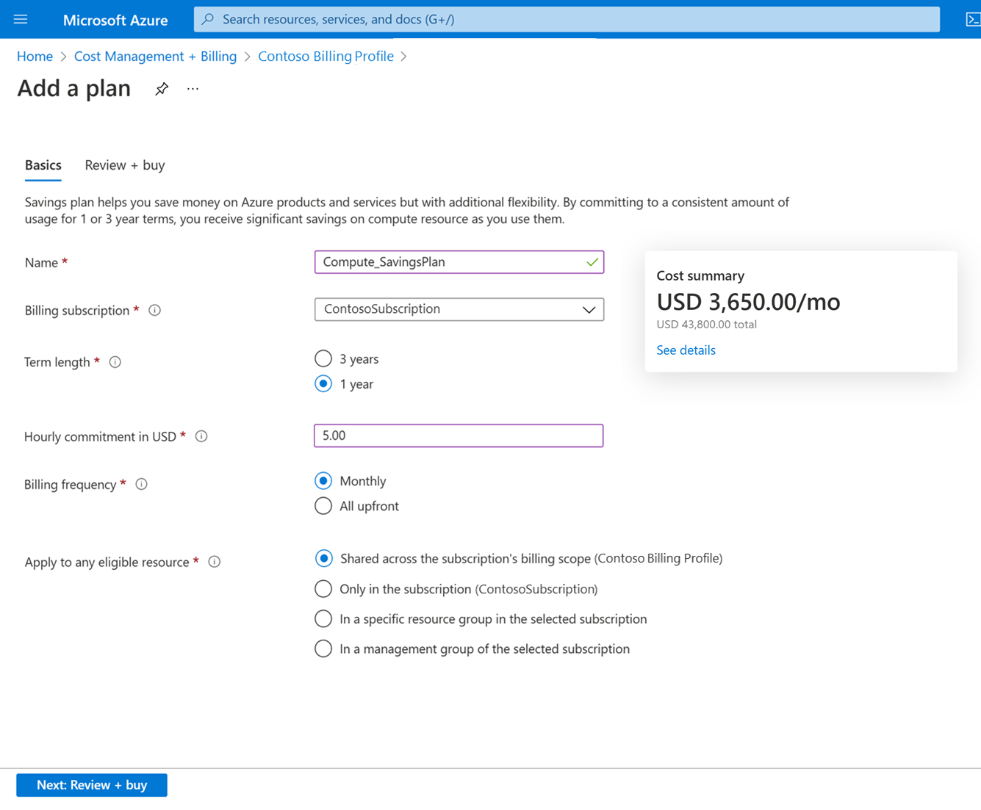
Save on your terms
Quick and easy to purchase with flexible plan options to fit customers’ needs
Save on compute usage by choosing a 1- or 3-year term
Get help setting the optimal hourly commitment amount with personalized recommendations based on your recent usage
Enjoy flexible payment options—pay all upfront or monthly at no extra cost
Streamline savings according to budget needs—scope plan to a subscription, resource group, management group or entire account
1
1
2
2
3
3
4
4
Example presented for illustrated purposes only

Slide 44



Evolving our compute saving options to better serve our customers
Changes to our 1- or 3-year savings options
Adding a new, flexible offer
Changing existing offer’s exchange policy
Azure savings plan
for compute
Reserved Instances

Slide 45
Cost saving options for different compute usage needs and patterns
 | Compute savings plan Most flexible savings for dynamic workloads while accommodating for planned or unplanned changes | Reserved instances Greatest cost savings for stable, predictable workloads with no planned changes
Savings compared to pay-as-you-go | Save up to 65% | Save up to 72%*
Commitment type | Spend a fixed hourly dollar amount on compute services collectively (e.g. Spend $5/hour on compute services for 1 year) | Usage of a specific virtual machine type in a particular Azure region (e.g. D2v4 virtual machine in Japan East for 1 year)
Savings apply | Across select services globally, up to the hourly commitment | Directly to the identified compute service in a particular region
Term | 1 or 3 year | 1 or 3 year
Payment options | Upfront or monthly | Upfront or monthly
Cancellation | No cancellations | Up to $50,000 USD
Azure savings plan for compute
Reserved Instances
*The 72 percent saving is based on one M32ts Azure VM for SUSE Linux Enterprise + 24x7 Support OS in the West US 2 region running for 36 months at a pay-as-you-go rate of ~$1,976.11/month; reduced rate for a 3-year reserved instance of ~$552.85/month. Azure pricing as of February 22, 2022. Prices subject to change. Actual savings may vary based on location, instance type, or usage.

Slide 46
Customers may have both Azure savings plan for compute and Reserved Instances
We automatically maximize customer benefit and savings across eligible usage each hour
When usage can be covered by either Reserved Instances or Azure savings plans for compute, reserved instances are used first, as they provide greater savings and have a more targeted scope
Azure savings plan for compute will apply to the remaining eligible usage until the commitment is fully consumed
Once a Reserved Instance or Azure saving plan for compute is fully consumed or expired, you will then be billed on a pay-as-you-go basis
Year 0
Year 1
Year 2
Year 3
Reserved instance (3-year)
+
Azure savings plan for compute (1-year)
Each term is unique and based on date of purchase

Slide 47
Q&A

Slide 48
Thank You

